Slide 1
Can We Achieve More with Less? Exploring Data Augmentation for Toxic Comment Classification
Group 5 Members:
Aya Metwally
Esraa Osama
Ahmed Nasser
Abdelrahman Ali

Slide 2
TABLE OF CONTENTS
01
02
03
04
Methods Applied
Research Results
Claims in the Paper
Research Goal

Slide 3
TABLE OF CONTENTS
How Claims are Supported
Claims and Results Missing from the Paper
05
06
Reasonable Next Steps
07
08
Conclusion

Slide 4
Research Goal
Investigate the use of data augmentation to overcome data scarcity in machine learning.
Build high-accuracy classifiers for toxic comment classification with limited data.
The ultimate objective is to make it possible to build precise models even with little data, which facilitates advancements in various domains of machine learning.

Slide 5
Methods Applied
Data preprocessing, train-test split, and sampling of a small training set.
Three learning algorithms: Logistic Regression, Support Vector Machines, and Bidirectional LSTM.
Two data augmentation algorithms: Easy Data Augmentation (EDA) and Backtranslation.
Evaluation metrics: Recall and F1 score.

Slide 6
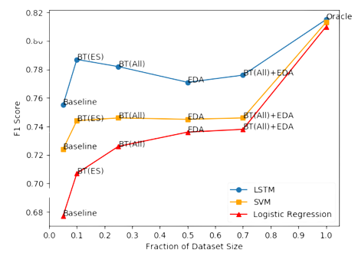
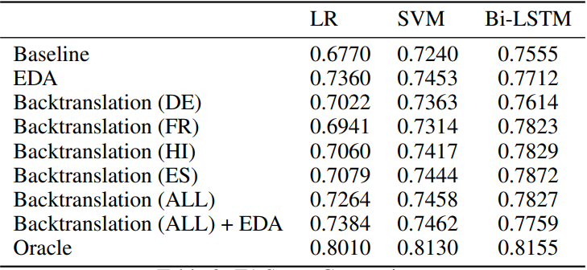
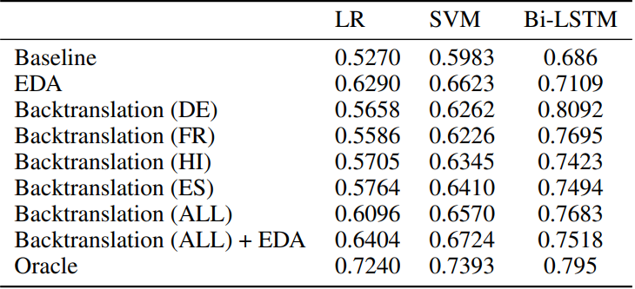
Research Results
F1 Score vs Size of Dataset
F1 Score Comparison
Recall Comparison

Slide 7
Research Results
EDA and Backtranslation improved F1 and Recall scores over the baseline.
Average improvement of 3% with EDA and 2.3% with Backtranslation.
Backtranslation was more effective for Bi-LSTM models, while EDA suited bag-of-words models like LR and SVM.
Experimented with four languages for Backtranslation; Spanish and Hindi gave the best results.

Slide 8
CLAMS
Translating the data to another language will improve the performance of Neural Machine Translation models.
high-accuracy classifiers can be built
from small datasets
data augmentation techniques can be used to improve the performance of classifiers.

Slide 9
High-accuracy classifiers can be built from small datasets
EDA
Baseline
77 %
76 %
BT+EDA
BT(ES)
78 %
79 %

Slide 10
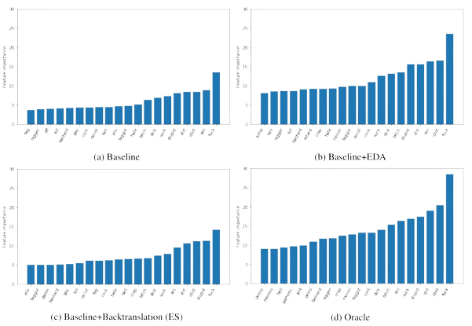
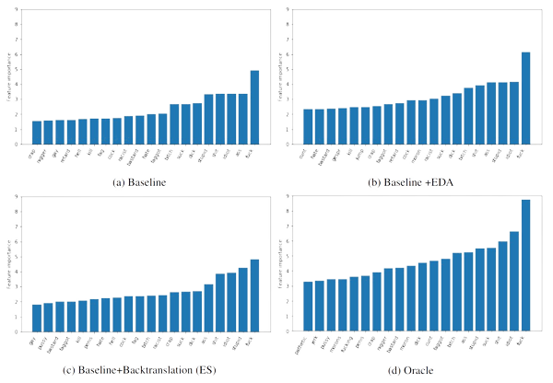
data augmentation techniques can be used to improve the performance of classifiers.
Logistic Regression
SVM

Slide 11
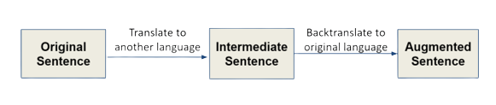

Translate the data to another language will improve the
performance of Neural Machine Translation models.
Languages
Spanish, French, Hindi, and German.

Slide 12
Missing Claims and Results from the Paper
Data augmentation can introduce noise.
Data augmentation can be computationally expensive.
Data augmentation can be time-consuming.
Speed and Efficiency of Data Augmentation Techniques

Slide 13
Performance of Augmented Classifiers on Different Levels or Types of Toxicity
continued..
Comparison of Augmented Classifiers to Other Methods
Performance of Augmented Classifiers on Different Datasets
Performance of Augmented Classifiers on Noisy or Intentionally Difficult Inputs

Slide 14
Next steps
Investigate the usage of additional data augmentation methods such as sentence fusion, word embedding perturbation, and synonym replacement.
Look at other NLP tasks' usage of data augmentation.
Develop a more comprehensive dataset for toxic comment classification.

Slide 15
Conclusion
this study emphasizes that both EDA and Backtranslation were effective in improving the performance of toxic comment classifiers.
The average F1 score improvement from EDA is 3% and Backtranslation across the four approaches studied is 2.3%.
Backtranslation is better suited for algorithms that operate under a bag-of-words model.
EDA is more advantageous for algorithms that consider the text’s semantic structure.

Slide 16
NIPS REVIEW CRITERIA
Quality
Clarity
Originality
Significance

Slide 17
References
Rastogi, C. (2020, July 2). Can We Achieve More with Less? Exploring Data Augmentation for Toxic Comment Classification. arXiv.org. https://arxiv.org/abs/2007.00875

Slide 18
THANKS!
Do you have any questions?
TeamNLP@outtawa.com

